Slide 1


Graph Databases Comparison: AllegroGraph, ArangoDB, InfiniteGraph, Neo4J, and OrientDB
Diogo Fernandes¹ and Jorge Bernardino^{1,2}
¹Polytechnic of Coimbra - ISEC, Rua Pedro Nunes, Coimbra, Portugal
²CISUC – Centre for Informatics and Systems of the University of Coimbra, Portugal

Slide 2
Study on: Graph Databases Comparison: AllegroGraph, ArangoDB, InfiniteGraph, Neo4J, and OrientDB
Team Members | Student ID
Mounica Ayalasomayajula | 015969759
Saumya Sinha | 016040674
Karnik Ketan Kalani | 016038282
Vidushi Bhati | 015309736
Harsimran Kaur | 016003468

Slide 3
Introduction
The focus of this paper is the study of the main characteristics, advantages and use cases of graph databases. We study five of the most popular graph databases: AllegroGraph, ArangoDB, InfiniteGraph, Neo4J and OrientDB.
Problem
Data volume is increasing quickly in the recent times and the ability to store and process large amounts of data is also increasing. Current relational databases dominate the market, however their adaptability in processing connected data is low.
Solution
Graph Db in the current scenario is an optimal solution to handle intensely interconnected data as it provides an efficient way to store data and metadata.

Slide 4
Main Advantages of Graph Database
It supports ACID properties. For example, Neo4j.
Better optimization on gathering information than relational databases.
Supports storage in petabytes, easily expandable and is suitable for complex and irregular data.
Highly efficient for data mining and running deep data queries.
Performance:- Relationship queries in traditional databases will come to a halt as the number and depth of relationships grow whereas in graph databases it stays constant.
Flexibility:- Teams can move at the speed of business as graph model's structure and schema evolve as applications and industries change.
Agility:-Graph databases can change in parallel with the rest of the application and any evolving business needs thanks to test-driven development approaches.

Slide 5
OrientDb
OrientDB is an open source, multi-model NoSQL database management system that supports data models in documents, graphs, key/value, and objects.
The manipulation of the database can be done in Java, SQL or with Gremlin.
It uses document database and object orientation capabilities to store physical vertices.
It ensures the security of all confidential data by utilizing authentication, passwords, and data-at-rest encryption.

Slide 6
OrientDb
Some Use-cases:- fraud detection, network/IT operations, graph search,recommendation engines, master data management,identity management and forensic analysis.
Limitations:-
Lack of an import tool.
The documentation is often outdated.
Difficulties with the graph editor.
Some notable key features:-
It can embed documents like any other document database but also supports relationships;
Multi-master plus sharded architecture,providing horizontal scalability and reliability.

Slide 7
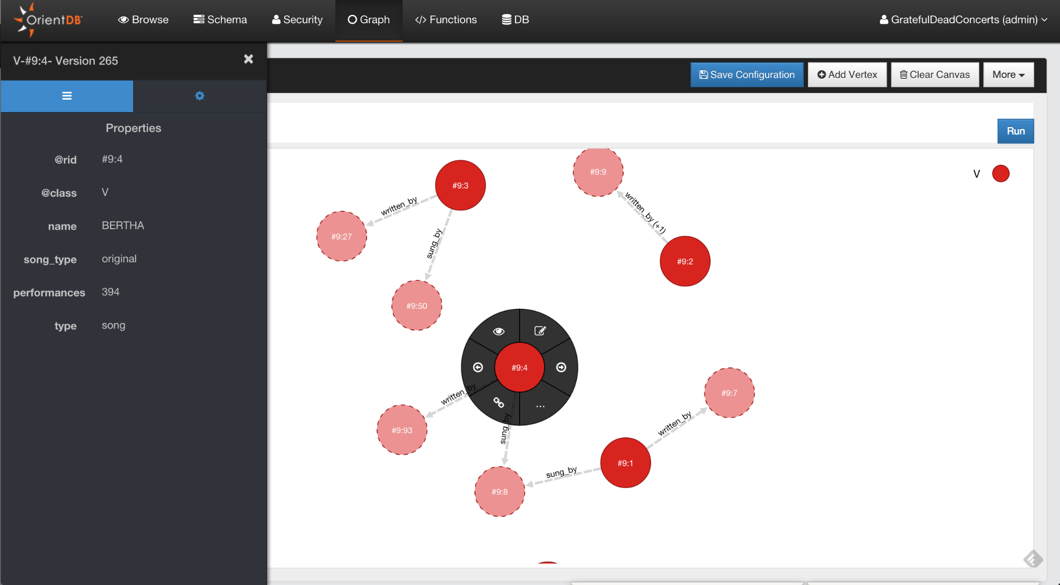
OrientDb
An Example of orient db interface
Sidebar bar shows nodes edges and properties.
Some edition functions on top right corner like add vertices or clear canvas.
When you click on the vertices you can see lot of options in circular fashion.
*Update
Support for Orient Db was stopped by SAP in 2021 and it has reached the end of its life.

Slide 8
ArangoDB
ArangoDb is a multi-model database .
Accessed by just one query lang (AQL-ArangoDB Query Lang)
By combining different models in one query makes data less complicated .
Advantages:
Simplified performance scaling– > Scales both vertically & horizontally per the needs of different data models.
Supports ACID transactions
Lower cost than other database.
The ArangoDB cluster architecture is a master / master CP (Consistent and Partition)model without a single point of failure.
ArangoDB eliminates need for multiple database deployment which decreases number of components and their maintenance.
Consolidates technology as stack in order to deploy and maintain systems to provide solutions for challenges to build fault tolerant systems.
Notes:
Simplified performance scaling– > ArangoDb scales both vertically and horizontally according to the needs of different data models
ArangoDB manages huge amount of storage memory in different data models with a single back-end, providing strong consistency on a single instance, and atomic operations when operating in cluster mode.
The ArangoDB cluster architecture is a master / master CP (Consistent and Partition)model without a single point of failure which means the cluster continues to fulfill requests even when a machine fails.
ArangoDB eliminates need for multiple database deployment which decreases number of components and their maintenance –->simplification leads to lower cost– > increased flexibility.
ArangoDb uses multi model databases and consolidated technology stack in order to deploy and maintain systems and provide solutions for challenges to build fault tolerant systems with many unrelated components.

Slide 9
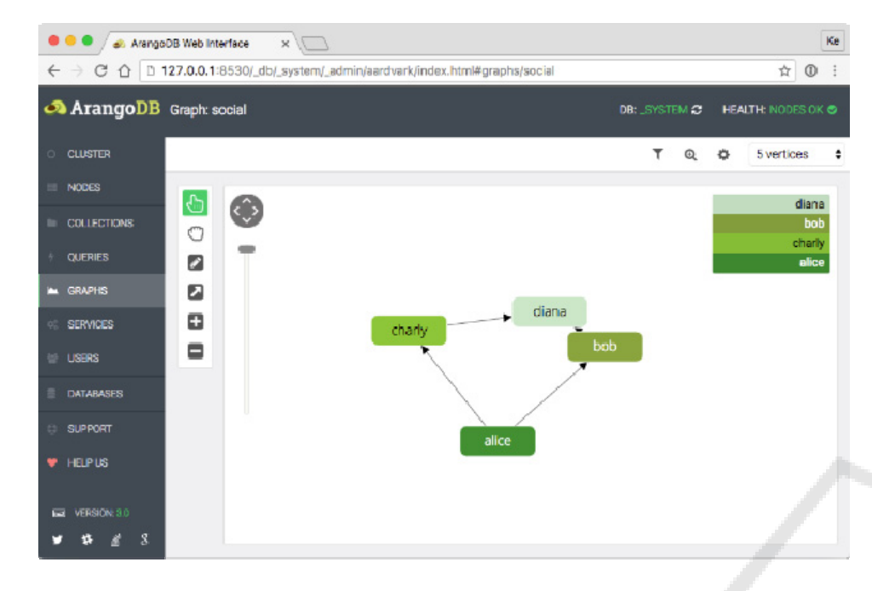
Limitations:
Software complexity may need an expertise hands despite of all available documentations.
Use cases:
Mostly used in Financial sector –Barclays
For access and identity management, Leveraging Smartgraph features for handling nodes and edges.
Telecommunications:
Network Analytics
Outage Predictions

Slide 10
Allegro Graphs:
AllegroGraph is a Multi-model (Document and Graph) database technology which enables the businesses to extract insightful decisions and predictive analytics from their highly complex, distributed data that can’t be answered with conventional databases.
AllegroGraph uses efficient memory management along with disk-based storage, enabling it to scale to billions of triples/documents
Advantages:
Supports SPARQL is used as query language,REStful HTTP API,programming languages such as C#,JAVA,Python,Scala.
Sorted quintuple indices that will index every primary and non-primary field so users never have to worry about whether a certain field is indexed or not.
Supports ACID property,Transactions: Commit, Rollback, and Checkpointing.

Slide 11
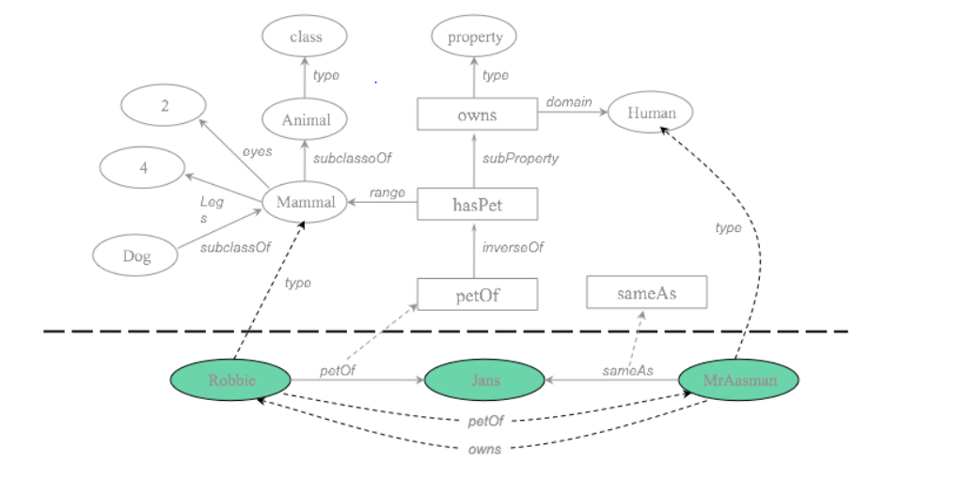
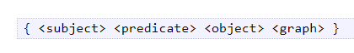
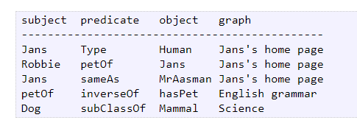
Single query can be formed by combining Geospatial,Temporal,Social Network Analytics and Reasoning.
Cloud-Hosted AllegroGraph - Amazon EC2.
Limitations:
Focuses on geo-temporal reasoning and social network analysis.
Expensive as compared to other databases.
Use Case:
Currently in use in open source, commercial, and US Department of Defense projects.

Slide 12
Neo4J
It is a fully transactional open-source graph database and a persistent java engine which helps to store structures in the form of graphs i.e. nodes and relationships instead of tables or documents. It was created in 2007.
It helps us find several hidden connections inside a big data and find links between them with the help of its visually interactive graphs.
Neo4j is a native graph database, which means that it implements a true graph model all the way down to the storage level. We can store and manage the data in a highly disciplined manner.
Enterprise edition and community edition mostly differ in greater scalability of the database, strong management of database locks, detailed monitoring of the system, high cache memory performance, an existence online backup along with some others.
Few use-cases of Neo4J are real-time recommendations, identity and access management, network and IT operations, fraud detection, knowledge graphs, anti-money laundering, graph analytics and algorithms, graph powered AI, smart homes, IOT.

Slide 13
Neo4J
Neo4J can run in both embedded mode (it can be invoked or used in other applications by calling for Neo4J libraries) and sever mode (Neo4J server includes HTTP server that can host Neo4J browser). Server mode is usually a common method to implement a database and on each server there is an embedded instance of Neo4J.
Characteristics of Neo4j: Schema optional (can be schema-based or schema-less), uses property graph data model, reliable and scalable, cypher query language, HTTP API to manage the database, index support using Apache Lucence, drivers support (like java, javascript, scala), online backups, cloud enabled, exporting query data to JSON and XLS format, most active graph community, high performance because of native graph storage and processing, easy to learn and use, easy to load data into the software, whiteboard-friendly data modelling.

Slide 14

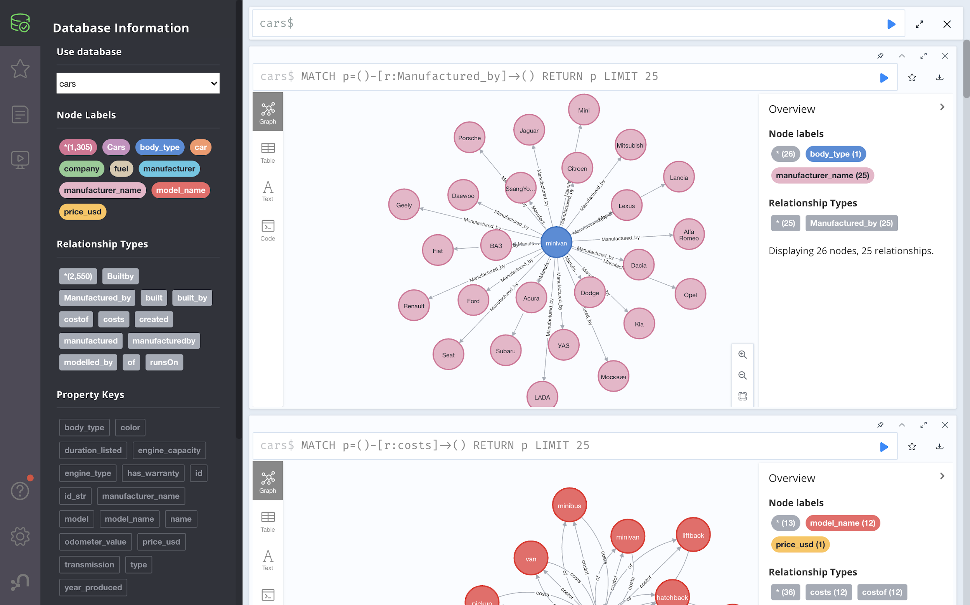
Neo4J
The left part of it shows the database information, node labels, relationship types, property keys.
In the middle, there is an example with nodes and relationships and attribute names. On the top, there is a query section in cypher language.
The right part gives similar information as the left i.e. an overview about our graph example.
Limitation of Neo4j:
The free version has limitations on the number of nodes, relationships and properties.

Slide 15
InfiniteGraph
An enterprise distributed graph database implemented in Java and C++ and uses a class of NoSQL technologies focusing on graph data structures where data and processing are distributed.
It is used to find useful and often hidden relationships in a highly connected and complex big data sets. It can only be stored in a physical disk drive.
Some of the main features and advantages of InfiniteGraph include:
Massive scalability (inherited from objectivity db), Parallel query support
Distributable (supports cross-boundaries edge connectivities), Distributed Ingest ( Ingestion of various data source types that include flat files (comma, pipe and tab types) and relational database tables)
Processing capabilities (High Performance)
Cloud storage and enabled, Online backups
API/Protocols: JAVA (core C++)
Multi-property graph model, Multi-threading processing, Cost-Effective

Slide 16
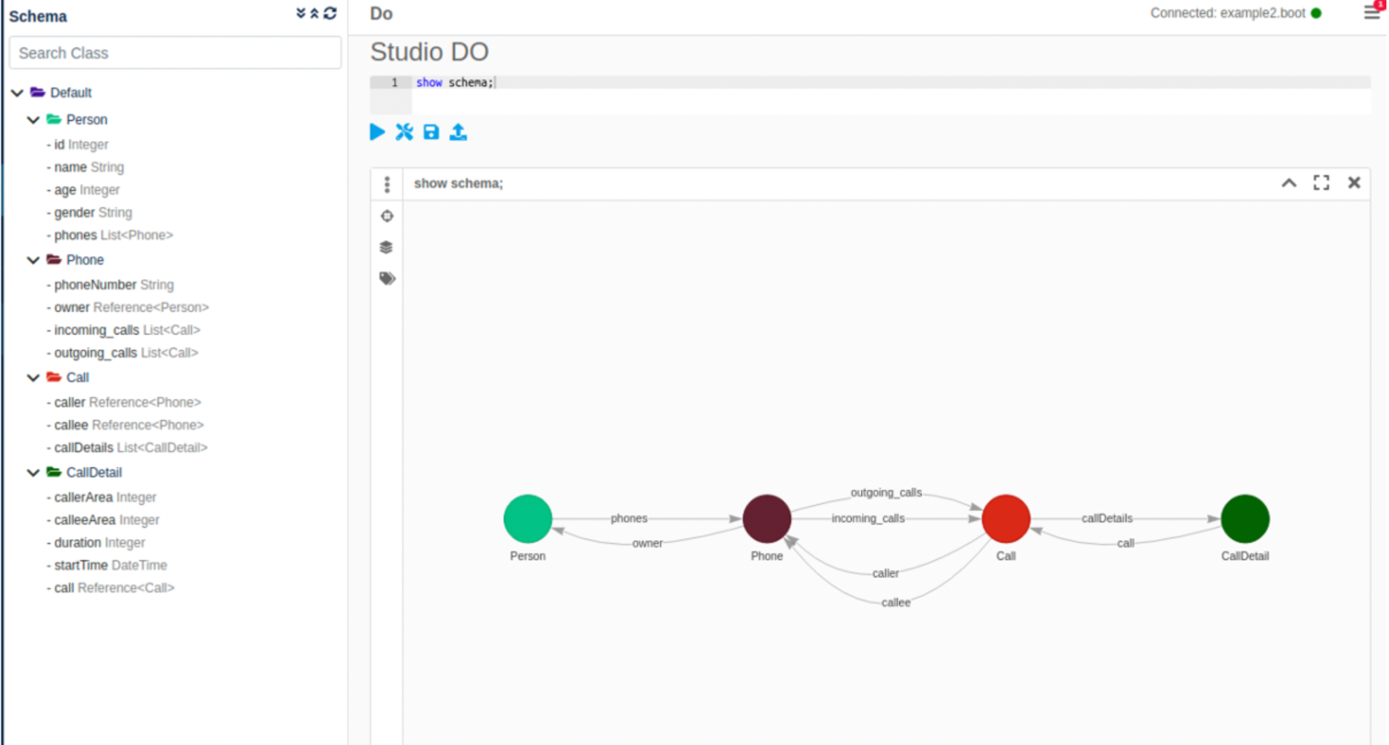
InfiniteGraph
Use Cases in: cyber security, network management and telecommunications, healthcare, crime prevention, predictive analytics and fraud detection, bioinformatics, genomics, scientific research, finance, social networking and many more.
It uses the DO query language which supports simple data retrieval queries, path queries, querying complex schemas “beyond graph”.
Limitation of InfiniteGraph:
Does not support sharding.
Does not have a free version.

Slide 17
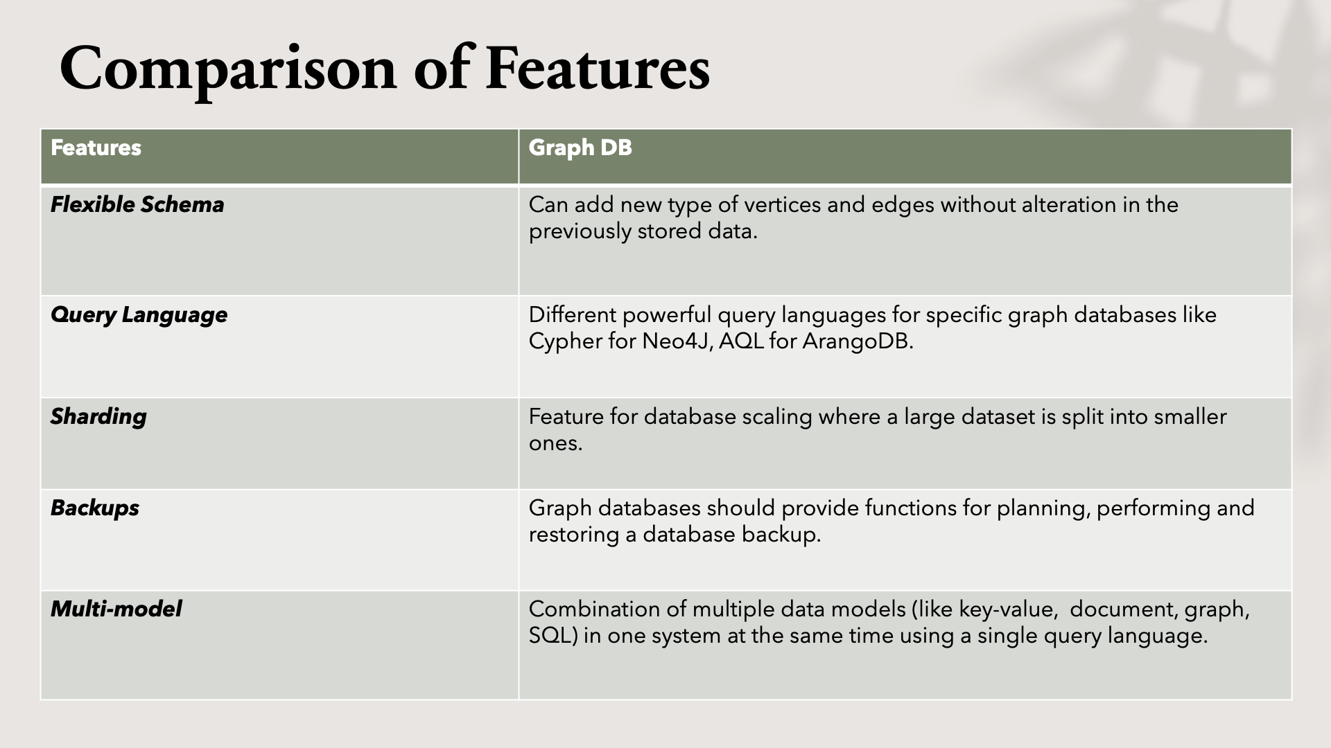

Slide 18
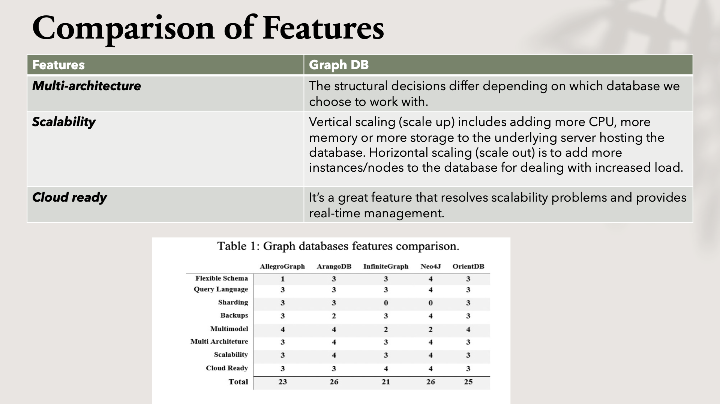

Slide 19
CONCLUSIONS
Graph databases provide more performance, flexibility and agility when compared to relational databases.
Here five of the most commonly used Graph databases have been analyzed: AllegroGraph, ArangoDB, InfiniteGraph, Neo4J and OrientDB.
The conclusion is that although they all serve the same purpose in terms of storing large volumes of data with several relationships between them, they differ in the functionalities they offer such as Neo4J is a single model graph database and cannot support a second database technology whereas ArangoDB is a multi-model graph database that allows you not only to use one database for everything but run adhoc queries on data stored on different databases.

Slide 20
KEY LEARNINGS
The functionalities of each database distinguishes them from one another and makes them better from one another thus, helping us choose the right database that serves our requirements. Thus, this analysis was made on the features of each of these graph databases.
The conclusion derived from this would be that Neo4J and ArangoDB offer better functionalities in order to implement a graph database.
Neo4J since it offers flexible schema option and an intuitive interface option it stands out. Moreover, its simple and uses a powerful query language named cypher.
ArangoDB also offers a powerful query language named AQL which is easy to learn and it also has a flexible schema option. Moreover, in comparison to Neo4J its a multi-model graph database it provides lot of flexibility and mainly supports sharding.

Slide 21
APPENDIX
Presentation - https://github.com/DecipherData/data225semproj
Key Learnings - Key Learnings
Topic and contents of the paper - Study on: Graph Databases Comparison: AllegroGraph, ArangoDB, InfiniteGraph, Neo4J, and OrientDB: Introduction , Main Advantages of Graph Database , OrientDb , ArangoDB , Allegro Graphs , Neo4J , InfiniteGraph , Comparison of Features , CONCLUSIONS , References
Source of the Significant Paper - https://www.scitepress.org/papers/2018/69102/69102.pdf
Slides - Based on our understanding of the significant paper we have chosen, we have prepared the slides for our presentation.

Slide 22
REFERENCES
Main Paper: https://www.scitepress.org/papers/2018/69102/69102.pdf
OrientDB: https://orientdb.org/docs/2.1.x/Graph-Editor.html/
ArangoDB: https://www.arangodb.com/docs/stable/getting-started.html
AllegroGraph: https://allegrograph.com/category/tutorial/
Neo4J: https://neo4j.com/docs/getting-started/current/
InfiniteGraph: https://infinitegraph.com/

